Slide 1
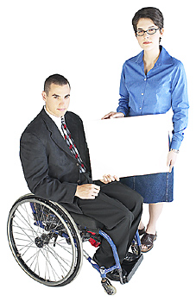
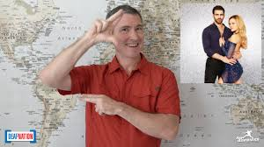


Creating Accessible Online Courses
Best practices
Notes:
In this presentation, we will address best practices in creating accessible online material. Much of the information will be for general online development. It is not specific to software or learning platform with the exception of Blackboard.

Slide 2
Goal and outcomes
The goal of Web accessibility is for all users to be able to receive, use, and manipulate content and functionality, in all forms.
The outcomes are to:
Identify the term web accessibility
Identify ADA Compliance, Section 508, and WebAIM
Identity what may be considered a disability
Apply basic accessibility standards to an online format
Notes:
The goal and outcomes are
Identify the term web accessibility
Identify ADA Compliance, Section 508, and WebAIM
Identity what may be considered a disability
Apply basic accessibility standards to an online format
We will address the What, Why, and How of accessibility

Slide 3
Learners and applications
 | Second Language Learners & Diverse Culture | Returning/Older or Nontraditional Students | Traumatic Brain Injury Cognitive (Hidden) Disability | Mobility Disability | Vision Loss | Hearing Loss
Use of Graphics | X | X | X |  |  | X
Text-to-Speech | X | X | X | X | X
Text Captioning/ Transcripts | X |  | X |  |  | X
Clear and Concise Language | X | X | X
Few Navigational Links |  |  | X | X
Keyboard Commands |  |  |  | X | X
Large Print |  | X |  |  | X
Descriptive Text | X | X | X |  | X
Sign Language Translation |  |  |  |  |  | X
Notes:
Let's take a look at what kind of learner can benefit from The applications listed. These are suggested ideas and are not limited to only those listed.

Slide 4
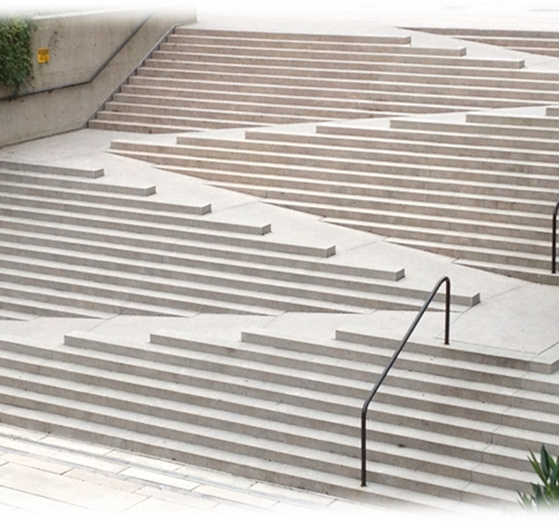
Accessibility
Everyone should have access to information. Access means for individuals to be able to receive, use, and manipulate this information whether or not the individual has a disability.
Access should not be an issue.
(Source: WebAIM.com)
Steps that are accessible having ramp, steps, handrails, and offering options for climbing.
Notes:
Access should not be an issue.
Online content must be designed, and correctly formatted, to be easily accessed.
Since most instructional materials are now digital and delivered to students via the Web, instructors are responsible for creating learning materials that meet students’ Web accessibility needs.
The What…Since much of the information we access is digital and on the internet, more attention in creating access in a digital environment has been increased. Having access is not just an opinion of doing the right thing-it is the law!
Everyone should have access to information. Access means for individuals to be able to receive, use, and manipulate this information whether or not the individual has a disability.
Access should not be an issue.
There are several laws that mandate accessibility.
For the purposes of this presentation, we will only briefly discuss a few of them. ADA Compliance and Section 508 of the Rehabilitation Act and WebAIM will be addressed. Becoming familiar with the law and information is encouraged.
A list of resources will be provided for you at the end in order to obtain further information. A copy of this presentation is also available through your instructor to access the links.
What makes this staircase accessible?

Slide 5

Accessibility and the law
American with Disabilities Act (ADA)
What does the law have to do with it? Everything!
ADA Compliance:
The American with Disabilities Act (ADA) of 1990 Since the words “public accommodations” is stated as requiring equal access, this includes the internet. For example, if an institution uses websites, such as WordPress, it must also follow ADA compliancy.
A student typing on a laptop computer.
Notes:
Why:
American with Disabilities Act (ADA)
What does the law have to do with it? Everything!
ADA says no one with a disability can be discriminated against and has equal opportunities for employment, governmental services, commercial facilities, public accommodations, and transportation.
The American with Disabilities Act (ADA) of 1990 Since the words “public accommodations” is stated as requiring equal access, this includes the internet. For example, if an institution uses websites, such as WordPress, it must also follow ADA compliancy.
In 2010 the (ADA) published Standards for Accessible Design. “These standards state that all electronic and information technology must be accessible to people with disabilities.” (Source: Interactive Accessibility).
WordPress also must follow ADA compliancy. An example is ODU’s WordPress site, which is a resource listed at the end on the resource page.

Slide 6
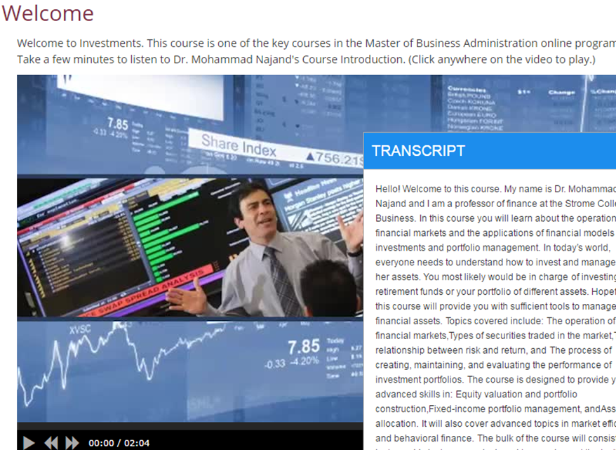
Why Accessibility matters
Institution’s responsibility to provide accessible instruction Section 508 “Federal agencies to make their electronic and information technology accessible to people with disabilities.”
WebAIM (web accessibility in mind) has the what, why, and how people with disabilities can access the web. People with disabilities that use the internet make up about 20%.
(Source: Section508.gov, 508 Checklist)
Image showing a video with a transcript to show more than one sensory output having access to the information.
Notes:
It is an institutions responsibility to provide instruction that is accessible and inclusive to all students. (ADA Compliance is federal law.)
Continuing with Why: Section 508 means that information does not rely on one sensory output. In 1973, The Rehabilitation Act was amended to include Section 508, which requires “Federal agencies to make their electronic and information technology accessible to people with disabilities.
For example, if information was in audio only, those with hearing loss could not access, if information was text only, those with vision loss could not access. Software and other technological devices are included within compliancy of Section 508. The image shows a video player, which displays audio, as well as a transcript for those needing to read what is being said word for word.
Section 508 ensures the accessibility for instruction of education, including higher education.
If there is any audio/video in something you create for others, be sure to assess if it needs transcripts. Accessibility is a must!

Slide 7
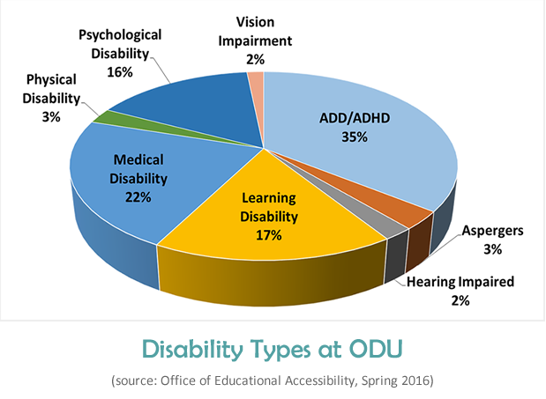
Major disability types include:
Visual-Blindness, low vision, color-blindness
Hearing-deafness and hard-of-hearing
Mobility-inability to use a mouse, slow response time, limited fine motor control
Cognitive-learning disability, distractibility, inability to remember or focus on large amounts of information.
Disability types by percentage at ODU
Note: Students must register with their institutions accessibility office
Notes:
Major disability types include:
Visual-Blindness, low vision, color-blindness
Hearing-deafness and hard-of-hearing
Mobility-inability to use a mouse, slow response time, limited fine motor control
Cognitive-learning disability, distractibility, inability to remember or focus on large amounts of information.
Why:
WebAIM (web accessibility in mind) has a vast amount of information including the what, why, and how people with disabilities can access the web. People with disabilities that use the internet make up about 20%.
I encourage you to visit the WebAIM site for information on how to create accessible documents,; i.e. ppt and Word

Slide 8
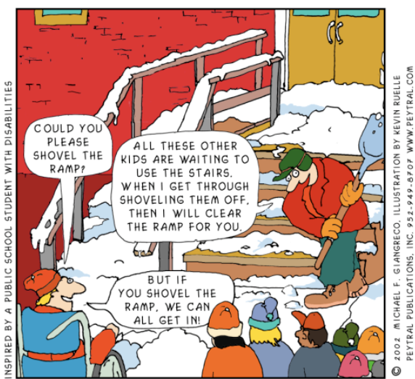
Clearing a path for people with special needs clears the path for EVERYONE!
Clearing a path for people with special needs clears the path for EVERYONE!
Notes:
Here is a cartoon image showing how providing access to those with disabilities actually creates accessibility for everyone.

Slide 9
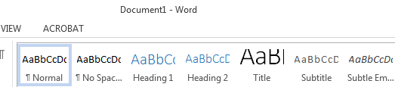
Accessible documents
Word
PowerPoint
PDF
Before a document goes into your LMS, it should be accessible.
If anything, think about heading styles and structuring for readability - screen reader

Slide 10
Structure, format,
& heading styles
Word
Creating Accessible Microsoft Word Documents (NCDAE)
Creating Accessible Word Documents (WebAIM)
PowerPoint
Creating Accessible Microsoft PowerPoint Presentations (NCDAE)
Write for readability and scannability – How?
  Structure headings
  Add descriptive ALT or caption text to images
  Format lists
  Font styles indicating importance
  Descriptive links
  Structure layout (use tables for data, not columns)
  Add Table of Contents to long documents
Notes:
Word, PPT and PDFs need particular formatting and designing for accessibility. The process is much like making webpage content accessible
Let’s look at this powerpoint as an example

Slide 11
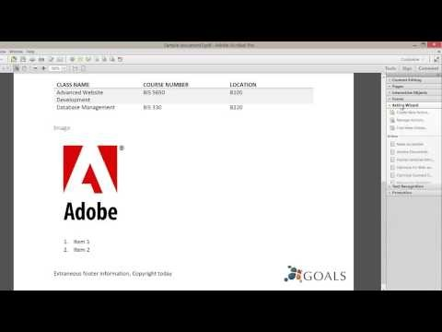
Structure, format,
& heading styles
PDF
PDF
Creating Accessible Documents in Adobe Acrobat XI (NCDAE)
Making a PDF Accessible – Step by Step (County of Sonoma)
Converting Documents to PDF (WebAIM)

Slide 12
Writing for the web or learning management system
Add bullets and lists
Use action words and active voice
Front-load important information
Add white-space
Replace text with graphics or multimedia
Add more headings and subtitles
The more text on a webpage or online document, the less of it students read. They scan for information in an F-pattern, instead.
Notes:
How easy is it for your students to view and understand your instructional materials? This is “readability” defined. Students (and you) view text and content differently on a computer screen than on a printed page.
You should of course develop your instructional materials to academic standards. But, to make your text more accessible, revise it for how students DO read online:

Slide 13
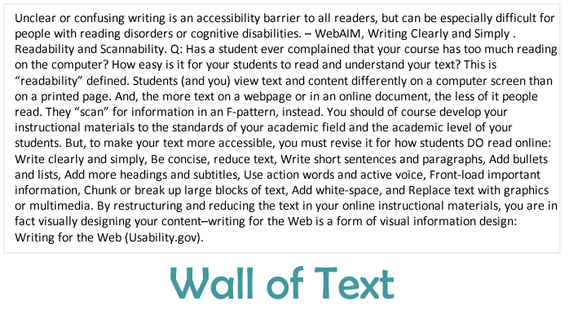

Wall of text example
Write clearly and simply
Be concise, reduce text
Chunk or break up large blocks of text
Write short sentences and paragraphs
Writing for the Web (Usability.gov)
Writing for the Web (NYU)

Slide 14
Structuring text
Unclear text can be clear and simple and text can be concise to reduce repetitive or reoccurring text. Text can also be chunked or separated into blocks of text to create paragraphs.
Write clearly and simply
Be concise, reduce text
Chunk or break up large blocks of text
Write short sentences and paragraphs
Unclear text can be clear and simple. Text can be concise to reduce repetitive text.
Text can also be chunked into blocks of text to create paragraphs.

Slide 15
Writing links
Don’t use “click here,” “Download this, “ or “Learn More” (Smashing Magazine)
Write descriptive link text (give context to what the link does)
Don’t underline non-links
Avoid displaying URLs, unless the link can’t be clicked (in multimedia or print, e.g.)
Add ALT text, if the link needs more explanation
Hyperlinks are essential functionality for most Web-based instructional content. They also must be written for accessibility.

Slide 16
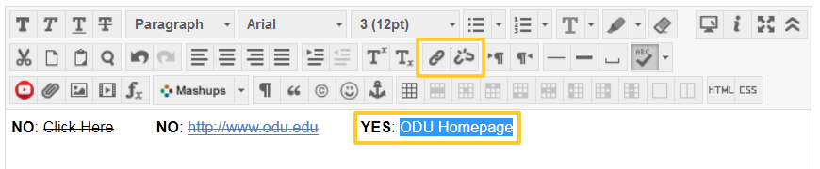
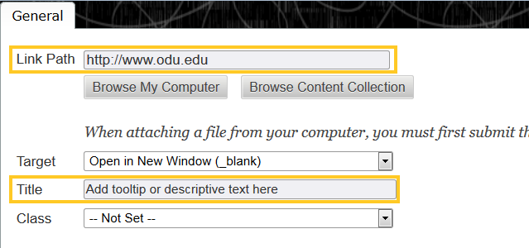
Activity: accessible links
Type descriptive link text
  YES example: Read the CAST Website, About Universal Design for Learning.
  No example: Read the CAST Website by clicking here.
Insert link url
Add link title or tooltip
In Blackboard, add white space (paragraph breaks) until the text is easier to view or more readable. Then, create a link.

Slide 17
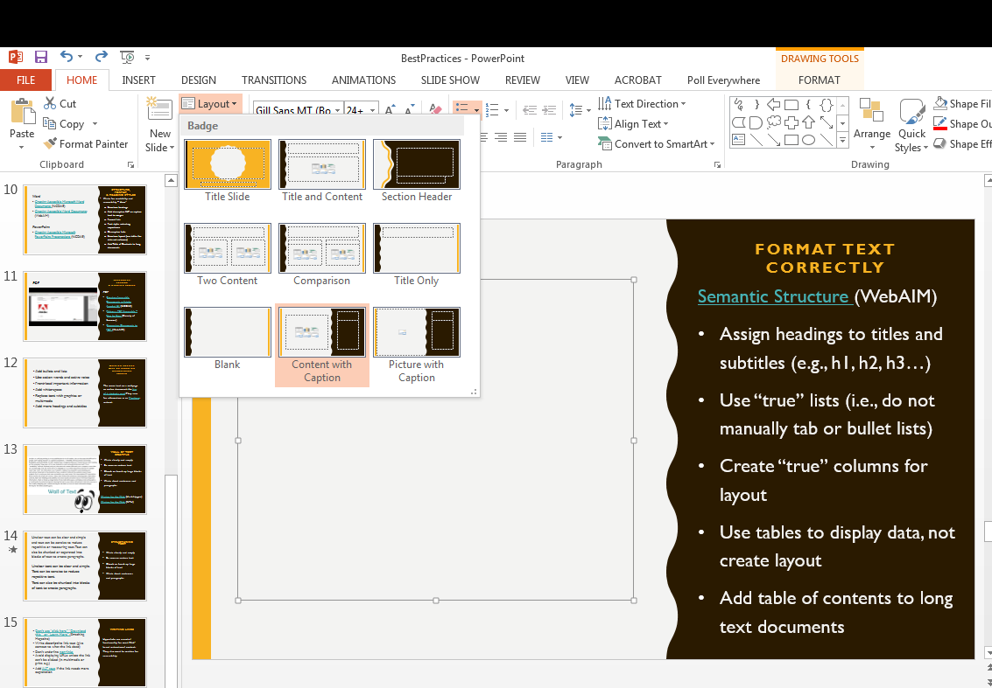
Format text correctly
Heading 1 (title)
Heading 2 (subtitle)
Heading 3 (subcategory)
Semantic Structure (WebAIM)
Assign headings to titles and subtitles (e.g., h1, h2, h3…)
Use “true” lists (i.e., do not manually tab or bullet lists)
Create “true” columns for layout
Use tables to display data, not create layout
Add table of contents to long text documents
Notes:
Have your students ever commented that your learning materials are a “wall of text?” To make your Web content more accessible, it needs semantic structure. “Semantic structure” simply means that the text is organized by priority and formatted correctly: your text is organized into titles, subtitles and paragraphs, for example.
Internet browsers and assistive technologies, like screen readers, rely on semantic structure to deliver, display, or process your webpages and online materials. Example: blind students use headings to navigate from section to section with a screen reader.
Web content editors and text editors contain built-in options for adding semantic structure. You can easily add heading styles to text or even convert text from tables using editing buttons. (Word, PPT, and PDF also have this for document accessibility.)

Slide 18
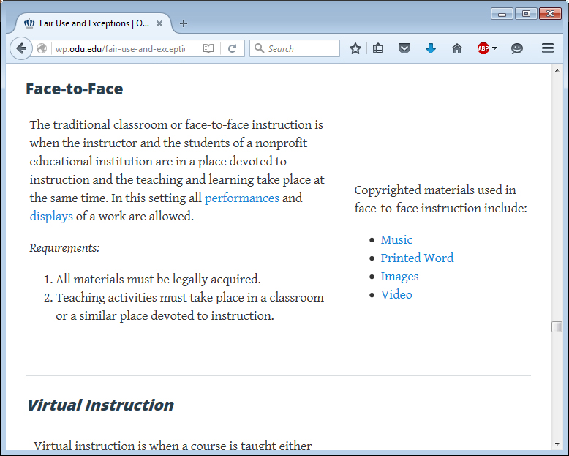
Layout With design structure
Headings
Subheadings
Numbered/bulleted
White space
Chunked
Meaningful words linked
Font used as bold and italics to show two forms of differentiation

Slide 19
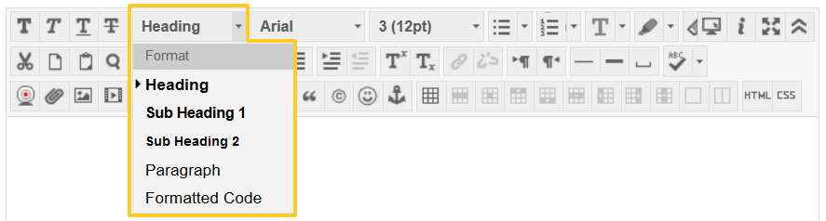
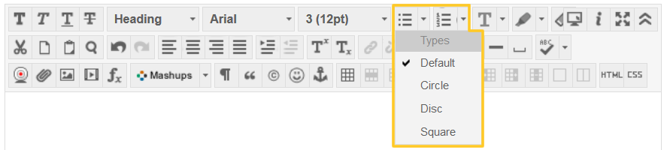
Activity: add structure
Apply Heading to “This is a Title”. Apply Sub Heading 1 to “This is a Subtitle”.
Apply list structure
In Blackboard, use the content editor to apply correct structure to text.

Slide 20
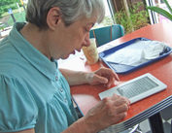
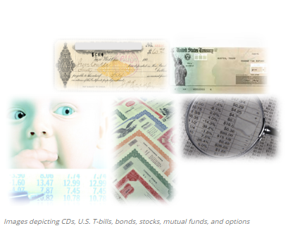
Visual benefits of accessibility
San serif fonts
Arial Narrow
Arial (regular)
Arial Black
Arial Rounded MT Bold
Calibri
Century Gothic
Franklin Gothic Book
Gill Sans MT
Impact
Lucida Sans
Microsoft Sans Serif
Myriad Pro Regular
Tahoma
Trebuchet MS
Tw Cen MT
Verdana
Woman reading an e-book
Large Print
Alt Text/
Text-to-speech
Descriptive text
fonts
Colorblindness
WebAIM:
Color contrast
checker
Images depicting, CDs, U.S. Treasury bills, bonds, stocks, mutual funds, and options
Notes:
Ok, now that all the formalities have been discussed, let’s get into the how’s of applying basic accessibility. We’ll start with the visual benefits of accessibility. Large Print.
Large print assists readers with low vision. It also helps readers to read easily in a noisy area where text is the only option.
Alt Text and Text-to-Speech allow for screen readers to read what’s on a page. Hearing the text allows for additional comprehension and support. Text should be able to be read by a screen reader. Incorporating alt text when using images or objects allows a screen reader to inform the user about what is on the page.
Text to speech is when the text is read aloud by an accessibility device, a screen reader, or other software -even software built in to many laptops and computers.
Using Alt text provides those with vision loss the same opportunity to obtain information of what others 'see' in an image or object.
Using descriptive text is another visual benefit. Descriptive text can be near ( or under each image as on this page and throughout the module)
Examples of descriptive text can be seen throughout the module describing each picture or graphic.
Fonts-use real text rather than something that is a text image, select basic, simple, easily readable fonts, which are (Sans Serif) fonts. A list of san serif fonts is available here.
Other tips are to use a limited number of fonts, be consistent with font size, avoid small fonts, and make sure there is sufficient contrast between the text and the background
When using images, best practices are:
Providing text alternatives for non-text content. This means to write in text format what an image, video, navigation arrows, photographs, etc. are portraying. Using alt tags help with doing this.
Use descriptive text to explain what an image is portraying

Slide 21


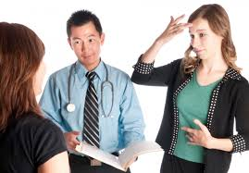
Hearing benefits of accessibility
Text captioning
transcripts
TV showing closed captioning
Sign language interpreter
Video example with a transcript
Source: W3C
Sign language interpreter
Notes:
Text captioning can be integrated with video as closed-captioned text with the option of turning it off or on. It can also be open-captioning where the text is on at all times. Text captioning can also be used in real-time as in a synchronous online course. development.
Transcripts also help with reading the information as opposed to listening to a video/audio. Second language learners can also benefit from reading the text
Translation of speech into sign language benefits people who are deaf, hard of hearing, or with a communication disability. Interpreting is done primarily in a face-to-face setting, however, can be used by way of a video

Slide 22
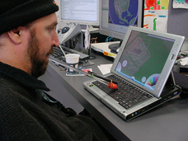
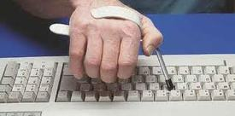
mobility benefits of accessibility
Keyboard commands
A man using an assistive device mouth piece to control the keys to his laptop.
Few navigational links/acceptable locations
A male using an assistive keyboard device to push buttons to type.
Notes:
Accessible mobility benefits create less stress for clicking and scrolling to a destination. These allow for manipulation of keys without using the keyboard. The top image shows how one could benefit with keyboard commands without having to use a mouse.
Also, having few navigational links help with less mobility effort for those who need a device to type with. Links should also be accessible and

Slide 23

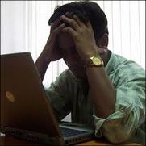
cognitive (hidden disability) benefits of accessibility
Clear and concise language
Use of graphics
Left figure shows a list of bulleted words. Right figure shows the same words displayed with interlocking circles depicting a relation among them.
Text to speech
Few navigational links
A man sitting at his laptop appeared to be frustrated with his hands on his head
Notes:
Using clear and concise language helps audience to understand meaning quickly and easily. Avoid jargon only known by a limited range of professionals. If in a career field or professional environment and you have an audience, don’t assume everyone knows the terminology you are using. There may be acronyms only known within your organization.
Use graphics when possible to display information more engaging on a page. The image shows a bulleted list on the left and the same list using interlocking circles on the right. The interlocking circles can visually display that the text is related.
Text-to-speech helps with cognitive or hidden disabilities in keeping a steady pace as well as acts like a guide to direct reading. You may have seen some devices using text to speech. Your laptop or computer should have this feature built in if it’s only few years old. Try it!
Having few navigational links not only benefits those with mobility disabilities, as mentioned previously, but it also benefits those who have processing challenges and need time to process information without going deeper into a site using multiple links. It is easy to lose your place and become lost and frustrated on a site.

Slide 24
Resources
Interactive Accessibility
Section508.gov
The American with Disabilities Act (ADA)
WebAIM.com
WebAIM: Color contrast checker
WebAIM http://webaim.org/intro/
W3C
ODU: Office of Educational Accessibility
ODU: WordPress
Notes:
Here are a list of resources used in this recording. I encourage you to research more resources and become familiar with accessibility as it may benefit those in their chosen career field.

